Slide 1

Ethics in Information Technology, Fifth Edition
Chapter 2
Ethics for IT Workers and IT Users
Lecture 3
Certification,
Government Licensing,
Compliance

Slide 2

Chapter 2 Ethics for IT Workers and IT Users Recap
Relation of IT workers with:
Client,
Suppliers,
Professionals,
Users &
Society
Why Code of Ethics?
Professional Organizations

Slide 3
Certification
Indicates that a professional possesses a particular set of skills, knowledge, or abilities in the opinion of the certifying organization
Can also apply to products
Generally voluntary
May or may not require adherence to a code of ethics
Employers view as benchmark of knowledge
Opinions are divided on value of certification

Slide 4
Certification (cont’d.)
Vendor certifications
Some certifications substantially improve IT workers’ salaries and career prospects
Relevant for narrowly defined roles or certain aspects of broader roles
Require passing a written exam, or in some cases, a hands-on lab to demonstrate skills and knowledge
Can take years to obtain necessary experience
Training can be expensive

Slide 5
Certification (cont’d.)
Industry association certifications
Require a higher level of experience and a broader perspective than vendor certifications
Must sit for and pass written exam
May need to pay annual renewal fee, earn continuing education credits, and/or pass renewal test
Lag in developing tests that cover new technologies
Are moving from purely technical content to a broader mix of technical, business, and behavioral competencies

Slide 6
Government Licensing
License is a government-issued permission to engage in an activity or operate a business
Generally administered at the state level in the United States
Often requires that recipient pass a test
Some professionals must be licensed – doctors, lawyers, CPAs, medical and day care providers, engineers
One goal: protect public safety

Slide 7
Government Licensing (cont’d.)
Case for licensing IT workers
Encourages following highest standards of profession
Encourages practicing a code of ethics
Violators would be punished
Without licensing, there are no requirements for heightened care and no concept of professional malpractice

Slide 8
Government Licensing (cont’d.)
Issues associated with government licensing of IT workers
There are few licensing programs for IT professionals
No universally accepted core body of knowledge
Unclear who should manage content and administration of licensing exams
No administrative body to accredit professional education programs
No administrative body to assess and ensure competence of individual workers

Slide 9
IT Professional Malpractice
Negligence: not doing something that a reasonable person would do, or doing something that a reasonable person would not do
Duty of care: obligation to protect people against any unreasonable harm or risk
Reasonable person standard
Reasonable professional standard
Professional malpractice: professionals who breach the duty of care are liable for injuries that their negligence causes

Slide 10
IT Users
Employees’ ethical use of IT is an area of growing concern because of increased access to:
Personal computers
Corporate information systems and data
The Internet

Slide 11
Common Ethical Issues for IT Users
Software piracy
Inappropriate use of computing resources
Erodes productivity and wastes time
Could lead to lawsuits
Inappropriate sharing of information, including:
Every organization stores vast amounts of private or confidential data
Private data (employees and customers)
Confidential information (company and operations)

Slide 12
Supporting the Ethical Practices of IT Users
Policies that protect against abuses:
Set forth general rights and responsibilities of users
Create boundaries of acceptable behaviour
Enable management to punish violators
Policy components include:
Establishing guidelines for use of company software
Defining appropriate use of IT resources
Structuring information systems to protect data and information
Installing and maintaining a corporate firewall

Slide 13
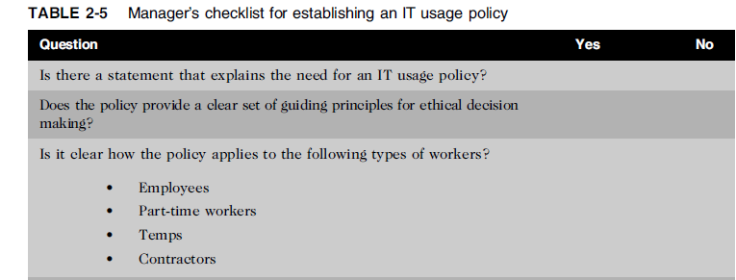
Supporting the Ethical Practices of IT Users (cont’d.)

Slide 14
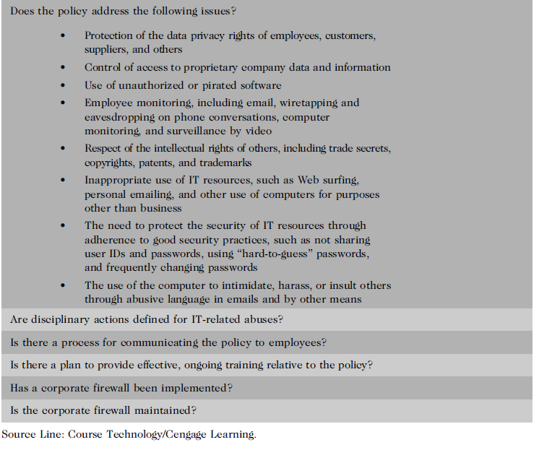

Slide 15
Compliance
To be in accordance with established policies, guidelines, specifications, and legislation
Sarbanes-Oxley – established requirements for internal controls
HIPAA – ensures security and privacy of employee healthcare data
Failure to be in conformance can lead to criminal or civil penalties and also lawsuits
Notes:
Health Insurance Portability and Accountability Act of 1996

Slide 16
Compliance (cont’d.)
Major challenge to comply with multiple government and industry regulations that are sometimes in conflict
To meet this challenge:
Implement software to track and record compliance actions
Hire management consultants for advice and training
Create Chief Compliance Officer position

Slide 17
Compliance (cont’d.)
Audit committee is subset of the board of directors, with oversight for the following activities:
Quality and integrity of accounting and reporting practices and controls
Compliance with legal and regulatory requirements
Qualifications, independence, and performance of organization’s independent auditor
Performance of company’s internal audit team

Slide 18
Compliance (cont’d.)
Internal audit committee responsibilities:
Determine that internal systems and controls are adequate and effective
Verify existence of company assets and maintain proper safeguards over their protection
Measure the organization’s compliance with its own policies and procedures
Insure that institutional policies and procedures, appropriate laws, and good practices are followed
Evaluate adequacy and reliability of information available for management decision making

Slide 19
Summary of the Chapter 2
Professionals
Require advanced training and experience
Must exercise discretion and judgment in their work
Their work cannot be standardized
From a legal standpoint, a professional:
Has passed the state licensing requirements
Has earned the right to practice in a state(s)
IT professionals have many different relationships
Each with its own ethical issues and potential problems

Slide 20
Summary (cont’d.)
Professional code of ethics
States the principles and core values essential to the work of an occupational group
Serves as a guideline for ethical decision making
Promotes high standards of practice and behavior
Enhances trust and respect from the general public
Provides an evaluation benchmark
Licensing and certification of IT professionals
Would increase the reliability and effectiveness of information systems
Raises many issues

Slide 21
Summary (cont’d.)
IT-related professional organizations have developed their code of ethics that:
Outlines what the organization aspires to become
Lists rules and principles for members
Includes a commitment to continuing education for those who practice the profession
Audit committee and internal audit team have a major role in ensuring that both the IT organization and IT users are in compliance with guidelines and various legal and regulatory practices

